Slide 1
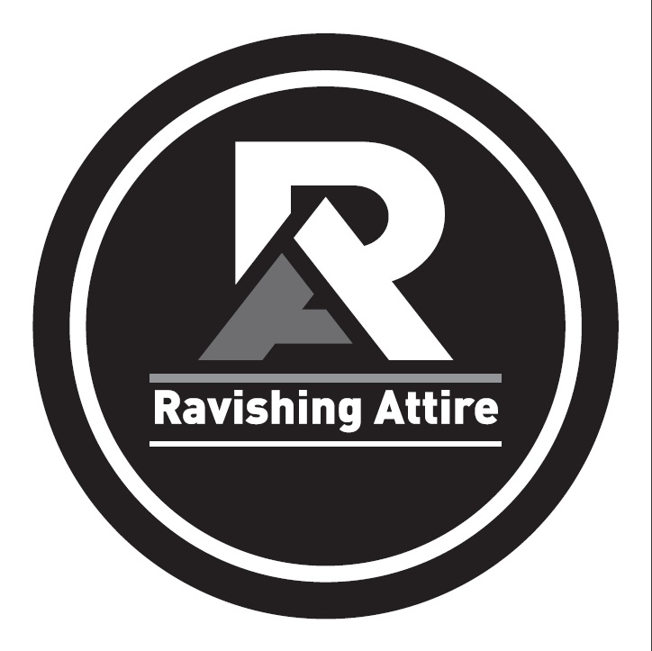
RAVISHING ATTIRE
Textile And Business Sourcing With Solutions, Apparel made with well expertise hands

Slide 2
Contents
WHO
WE ARE
&
01
02
03
04
Who we are & what we do
Why our customers love us
WHAT WE
DO
Customer service & responsibility
Quality
05
06
07
08
09
10
1 1
12
Design
RAVISHING ATTIRE
we source and create exceptional apparel that is sustainably
made and efficiently delivered at a fair price Quality with Smooth Shipment.
Efficiency & pricing
Previous clients
Our products - bestsellers
As consumer expectations rise, companies come under increased pressure
to deliver products to market faster, with more features, more product
lines and lower cost. We help our clients with specification development,
material cost, negotiation and pricing reviews to ensure a commercially
viable product.
Sweaters
Denim & Jeggings
Tank tops & t-shirts
Leggings & sweats
If you can't find exactly what you're looking for, we will find the right
textile and pair it with one of our partner factories, meaning you get access to your perfect product in a more affordable way.
Our clients love us and continue to work with us. We have been working
with many of them for over twelve years. It's a true partnership. We value them as much as they value us.

Slide 3
WHY
OUR
CUSTOMERS
CUSTOMER SERVICE
INNOVATION
You get a dedicated account
manager to ensure you have
someone to assist at every step
We keep ahead of the trends so
that we can advise you on your
design decisions
LOVE
US
EFFICIENCY
QUALITY
We offer a full product cycle ERP
operation to achieve delivery
excellency
We guarantee excellent quality
products as well as a top notch
service
PRICING
RESPONSIBILITY
We control everyaspectofthe
process so we can offer you the
best price possible
We care about people so we audit
and provide expert consultancy
across the entire supply chain

Slide 4
CUSTOMER
SERVICE &
RESPONSIBILITY
With you all the way
We know that with so many parts to the process, you need someone to be your point of contact
whenever you have a question. Our dedicated account managers have years of experience, and a wealth of knowledge, to help make the right choices and give you the confidence to move forward.
With your vision, and our experience, we work hand in hand to make sure you get the best finished
product.
Social responsibility & ethical supply
We provide expert consultancy across the entire supply chain to ensure our partners make
responsible decisions while remaining competitive in the garment industry. We collaborate with our clients to promote the understanding of their brand value in sustainable product supply. We deliver this through our consistency with the principles of a responsible company.

Slide 5
QUALITY
Quality management & testing
Whether your product will sit amongst the shelves of a discount retailer or luxury gifting, we build assured and meticulous quality management plans to ensure that the product our client signs off is the product they receive.
The products undergo all-important tests to control the quality level in terms of shrinkage, color fastness, spirality,
pilling, dimensional stability, button pull out, rubbing and all other physical tests.
Factory selection & compliance management
Whether your product will sit amongst the shelves of a discount retailer or luxury gifting, we build assured and meticulous quality management plans to ensure that the product our client signs off is the product they receive.
The products undergo all-important tests to control the quality level in terms of shrinkage, color fastness, spirality,
pilling, dimensional stability, button pull out, rubbing and all other physical tests.
04

Slide 6
DESIGN
New products & innovation
Whether from our in-house team of designers or alongside our partners, we can deliver the complete
product development cycle. We can support you through the entire process from 2D to a comprehensive
design for manufacturing. We can help your ideas become fully formed concepts, grounded in our
experience and knowledge of the industry.
Pattern & CAD
Our experienced technicians working on pattern and CAD ensure that the technical aspect, like shape
and fitting, match your expectations. We make measurement charts, cut paper pattern by auto cut hi
tech machine, print bulk marker, and figure out real time exact consumption to give you a cost guide.
'
%
..••.•.
I I
⁴.^{i}..
4
:;
tl
Quick sample turnout
Our in-house sample team has a capacity of 3,000 samples per month. Our close partnerships with the
leading suppliers in China, India, and Bangladesh allow us to manage the quickest turnout of proto
samples for our customers as proof of understanding the concept..
05

Slide 7
EFFICIENCY &
PRICING
Cost reduction
We understand that a competitively priced product is essential for a project's success. With international markets
fluctuating, currency falling and raw material costs rising, we know how critical it is to continue to deliver commercially
viable products to the consumer. We help our clients with specification development, material cost negotiation and
pricing reviews to ensure a commercially viable product.
Contingency & risk management
We believe contingency and risk management for our clients should be a completely customized service. We help our clients
understand the risks associated with the market they are manufacturing from and work to mitigate these risks. From
creating secure back up supply chains to eliminate lead-time failures, we work with our clients to eliminate the risks that
damage their market strategies.
Customs & clearance
Rayontex understands that fulfillment is much more than taking your product from one port to another. We understand the
complexities of international customs, shipment and clearance and are experts at building seamless logistics solutions.
Whether this is integrating through our client's regional distribution centers or time sensitive deliveries to independent
warehouses, we can fulfill your supply chain needs.

Slide 8
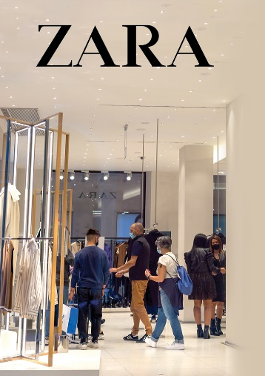
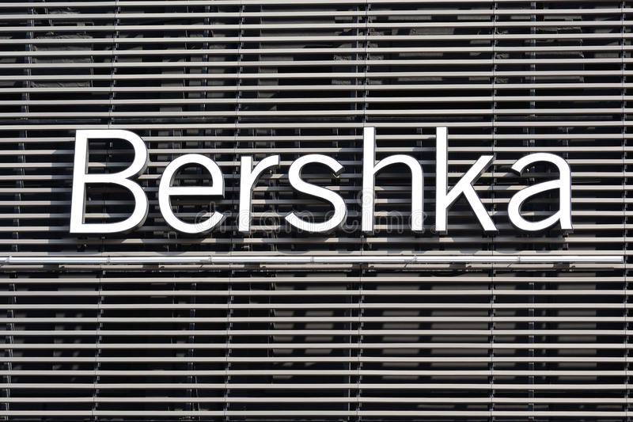
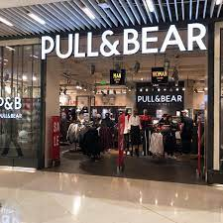
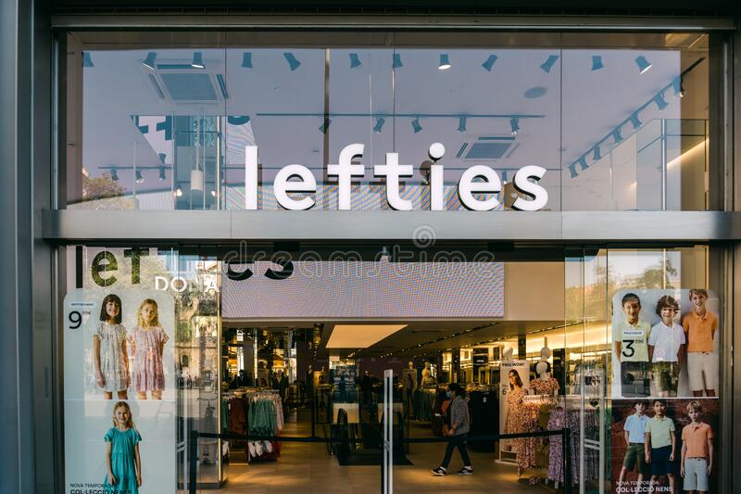
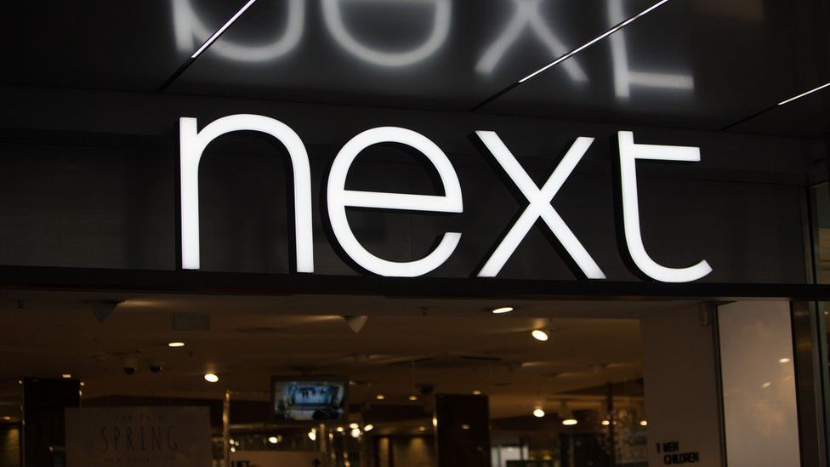
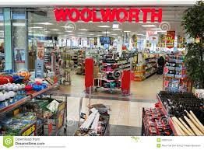
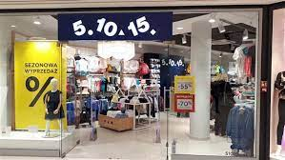
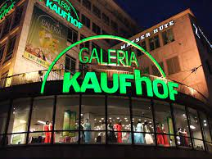
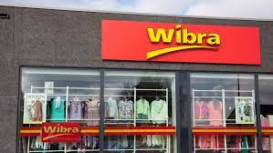
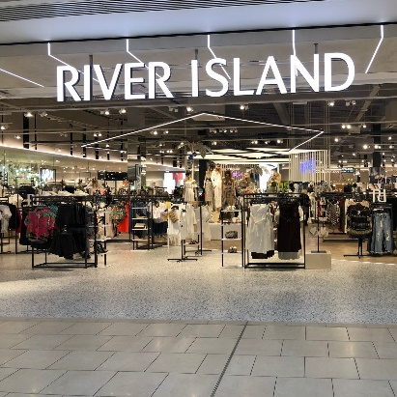
PREVIOUS WORK EXPERIENCE WITH
WORLD'S LEADING BRANDS

Slide 9
CERTIFICATES OF OUR MANUFACTURING PARTNERS HAVE
List of essential License & Certificate for a Garments factory compliance in Bangladesh:
Required Certificates for USA , UK, European Buyers
1. E.R.C
2. I.R.C
3. Factory Labor License.
4. Factory Layout Plan Approval.
5. Boiler Certificate.
6. Fire License.
7. Environment Certificate.
8. Chamber of Commerce & Industry Membership Certificate.
9. Membership & certification of Bangladesh Garments Manufactures & Exporters Associate (BGMEA)
10. VAT Certificate.
11. Trade License.
12. EPB Enrolment Certificate.
13. TIN Certificate.
14. Bank Solvency Certificate.
15. Article of Memorandum.
16. Certificate of Incorporation.
17. BOND License & General BOND.
18. PDB Testimonial.

Slide 10
Price is based on
-
-
-
-
European market size
Regular accessories
Volume order
Pre-booked capacity
OUR
PRODUCTS
=!
$3.9
95% cotton 5% elastane
160gsm
80% viscose 20%
nylon 12gg
95% cotton 5% elastane
180 gsm
95% cotton 5% elastane
YD stripe 180 gsm
95% cotton 5% elastane
YD 180 gsm
100% Acrylic Cashmere
like, 12gg
95% cotton 5% elastane
YD stripe 180 gsm
78% cotton 20% polyester
2%elastane, 9.5 oz
95% cotton 5% elastane
160 gsm
65% cotton 35% polyester
eve fleece 250g

Slide 11
SWEATERS
The softest knits
Our super-soft ladies knitwear collection is well loved for
the softest coziest layering pieces and includes the staple
crew neck and turtle neck jumpers along with button up
cardigans. Our ladies knitwear also includes knitted
cardigans with stylish details, to add to your smart casual
collections, as well as knitted jumpers with embellished
details, perfect on their own, or as part of a collection.
Luxury sweaters
Tex & Biz Corporation range of high quality fancy yarns sweaters are reflection of the fast paced trends in modern fashion,
interiors and pop culture design. Created from silk,
acrylics, angora, cotton, merino wool, nylon and alpaca to
name but a few, our fabulous fancy yarn sweater range is
sure to add something new and exciting to your project.
+
⁺.},
<·.
(

Slide 12
DENIM &
JEGGINGS
We know denim
Strong, durable and top quality, be it the classic skinny, ripped, boyfriend, wide leg, retro high•
waisted, low or mid rise, ankle rise, distressed, embroidered, or anything else. Our denim talks. There are no limits to what we can produce, so if you have an idea, our team can work with you to bring it to life. Jackets, jeans, shorts in any finish or wash you need.
We also have a large commercial collection for you to choose from if you just want something off the
shelf. With our expertise, we can keep within your budget, deliver a quality product and beat the competition every time.
The comfiest jeggings
We offer a wide range of women's jeggings. The popular pull on jeggings which feature an elastic
waistband and super-soft s stretch fabric for the ultimate comfort are the best sellers. To create a denim impression without compromising on comfort, our zip detail jeggings features a zip and button fly, pocket details and a super comfortable stretch cotton blend fabric. Our collection features a large
range of colors from classic washes, to red, green and black.

Slide 13
TANK
TOPS
&
T-SHIRTS
The softest knits
We produce essential vests and nightwear in impossibly
soft hand feel fabrics in a selection of colors and classic
stripes. This easy-to-wear style is a 95% cotton 5%
elastane mix, giving a little stretch, and lots of comfort.
Basic round neck t-shirts with chest print or embroidery in
soft marls and neutral colors. They come in fluid viscose
or medals in plain and AOP, perfect to add to your
collection for any season.

Slide 14
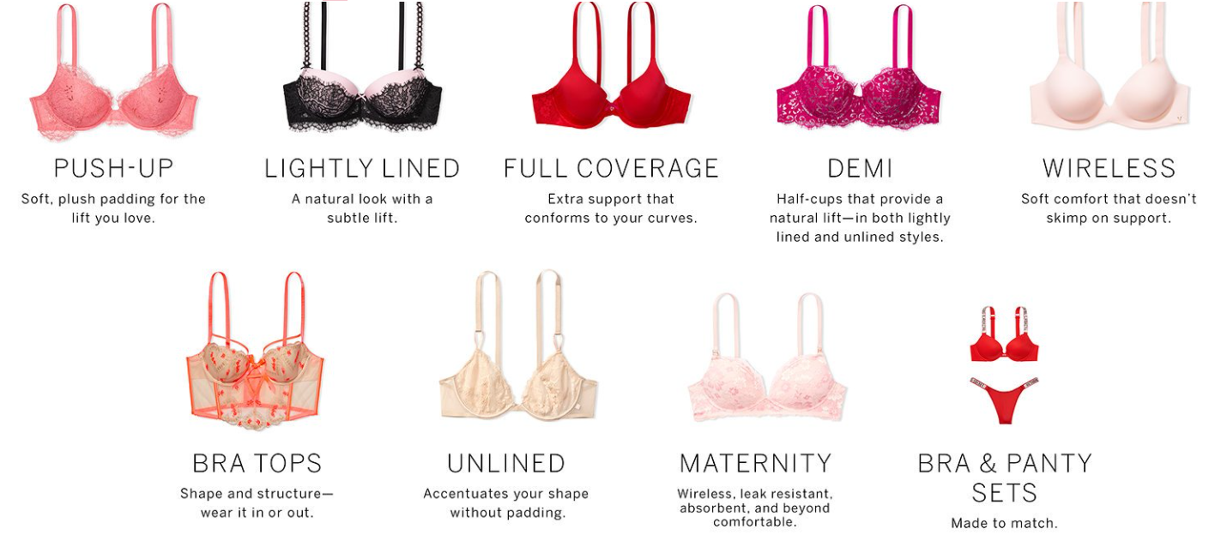
LINGERIE
Sexy knits
We produce essential Sexy Knits and nightwear in impossibly soft hand-feel fabrics in a selection of this easy-to-wear style is a 95% cotton 5% elastin mix, giving a little stretch, and lots of comforts.

Slide 15
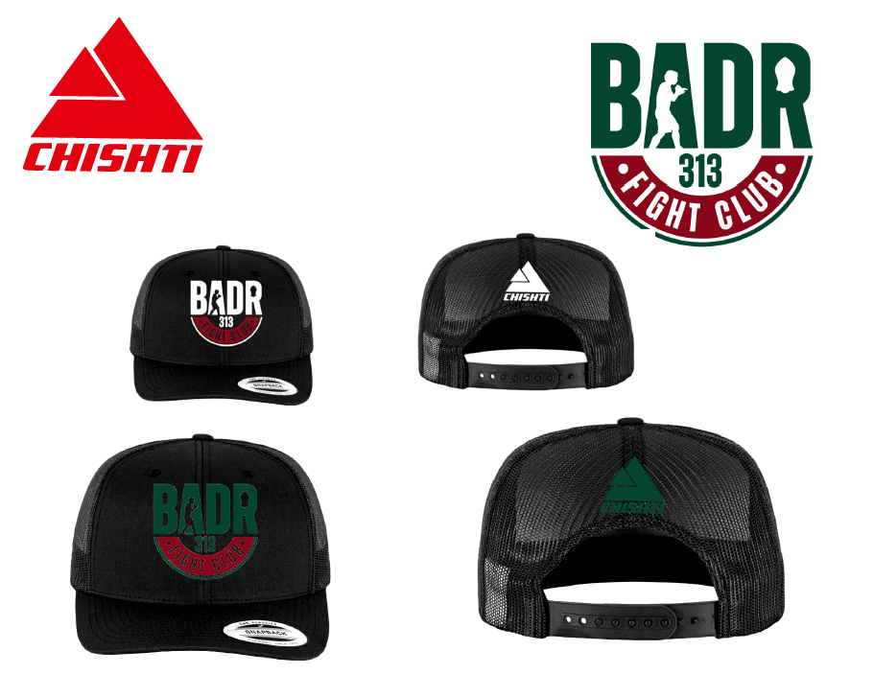
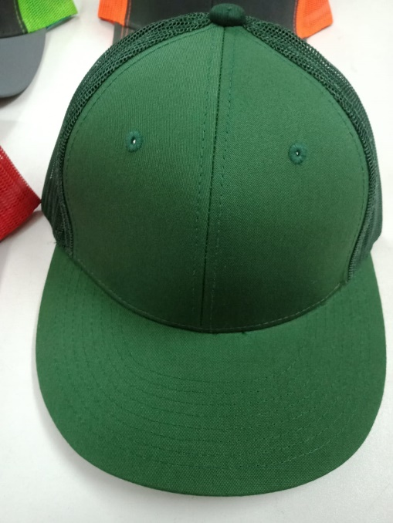
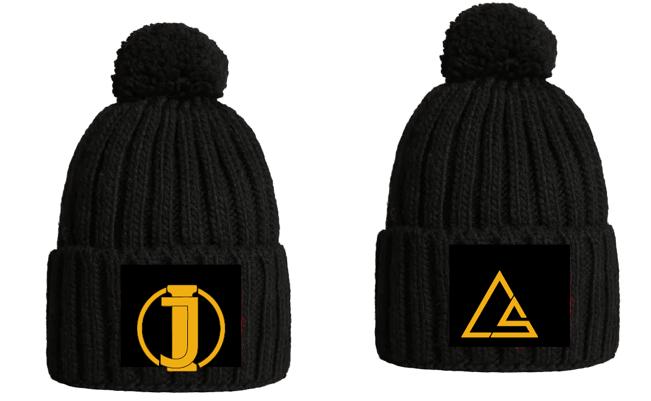
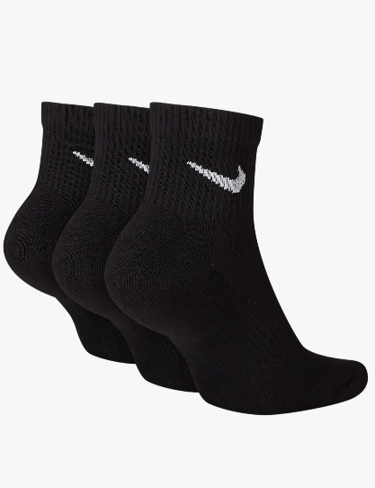
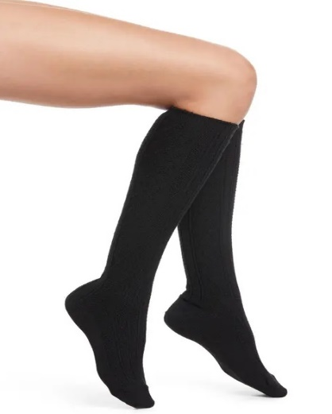
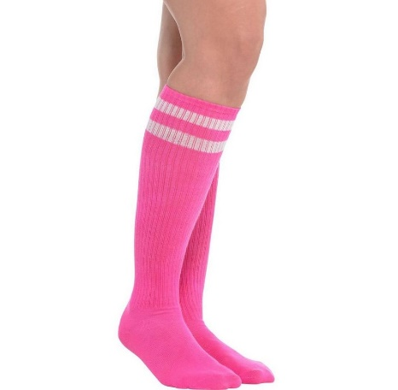
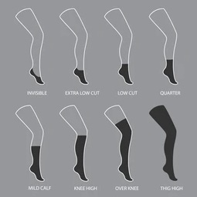
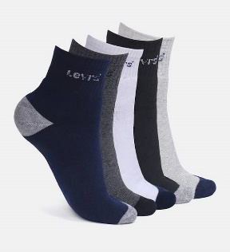
CAP’S
We produce essential Cap For All Fashion & Seasons, With Print, Embroidery, Also We make all kinds of Socks.
SOCK’S

Slide 16
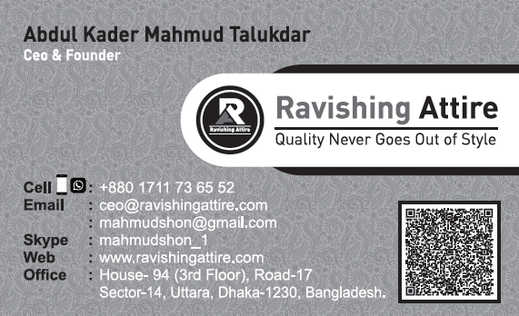
Bangladesh
RAVISHING ATTIRE
House - 94, 3rd Floor,
Road no – 17, Sector – 14,
Uttara, Dhaka-1230
CONTACT
To start a project or request
our
product brochures,
touch.
please
get
in
I
-◄
«-
-

